Slide 1
Angular Routing
Child Routes
Lecture 5
By James(Jin) Wang
12/26/2021

Slide 2
Outline
Using Child Routes
Configuring Child Routes
Placing the Child View
Activating Child View
Obtaining Data for Child Routes
Validating Across Child Routes

Slide 3
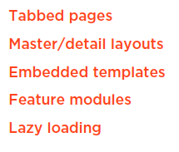
Using Child Routes
  Child Routes

Slide 4
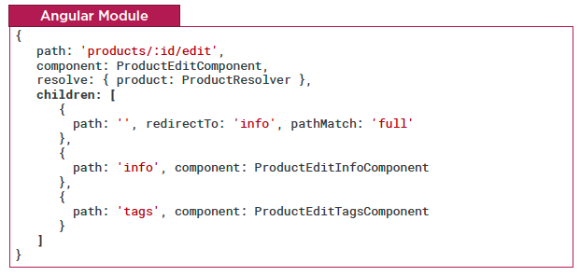
Using Child Routes
  Configuring Child Routes
  Demo: configure child route

Slide 5
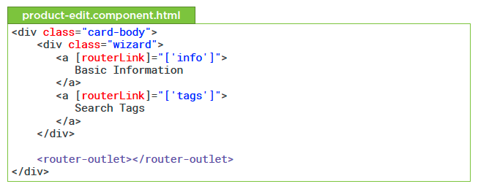
Using Child Routes
  Placing the Child View

Slide 6
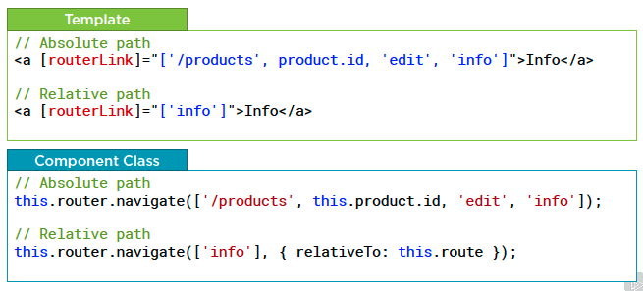
Using Child Routes
  Activating Child Routes

Slide 7
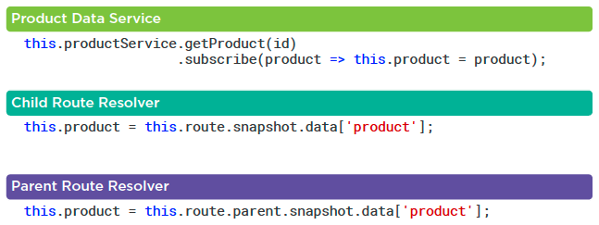
Using Child Routes
  Obtaining Data for a Child Route

Slide 8
Summary

Slide 9
Assignment

Slide 10
Self Study
  Angular Routing
  https://app.pluralsight.com/library/courses/angular-routing

